Slide 1



Slide 2
Instructor
Asima Nisar

Slide 3

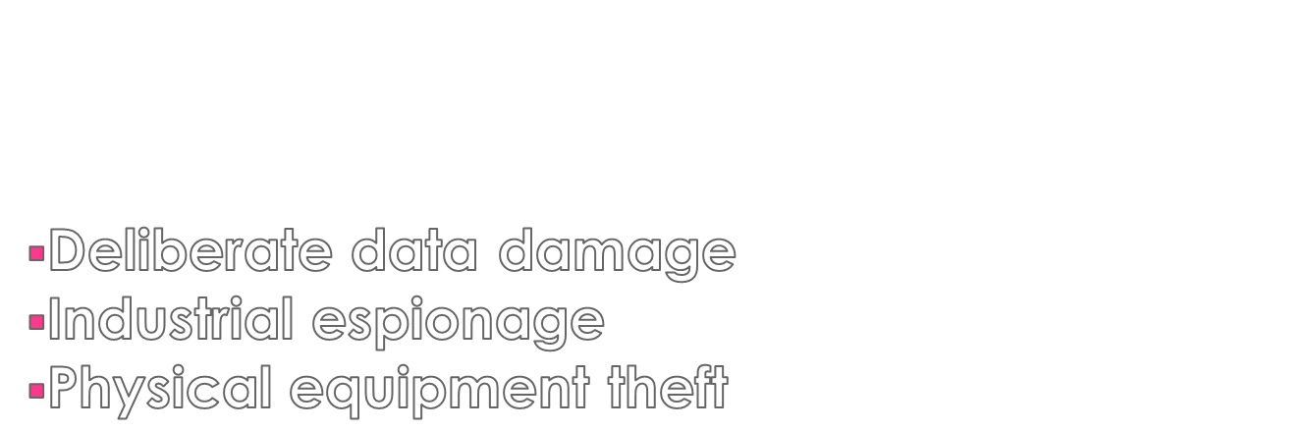


Slide 4

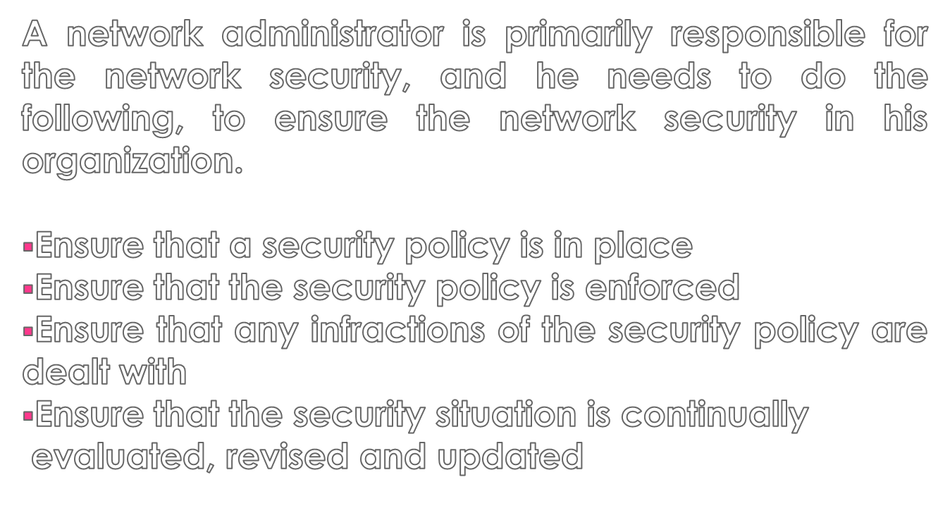

Slide 5

Security can be broken down into two distinct areas, physical security and logical security.
Security
Physical Security
Logical Security

Slide 6

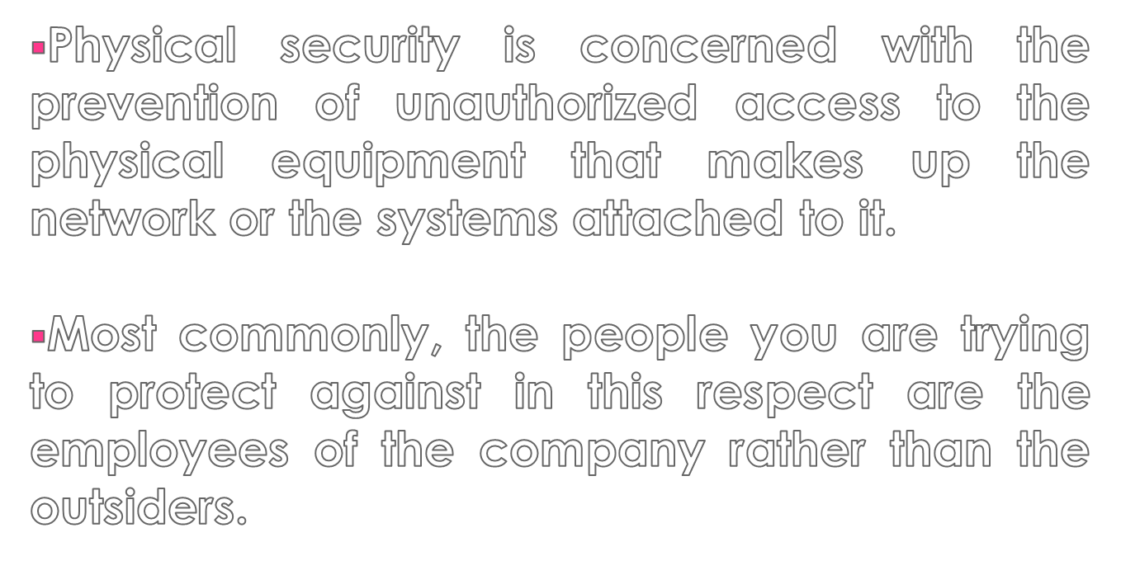

Slide 7

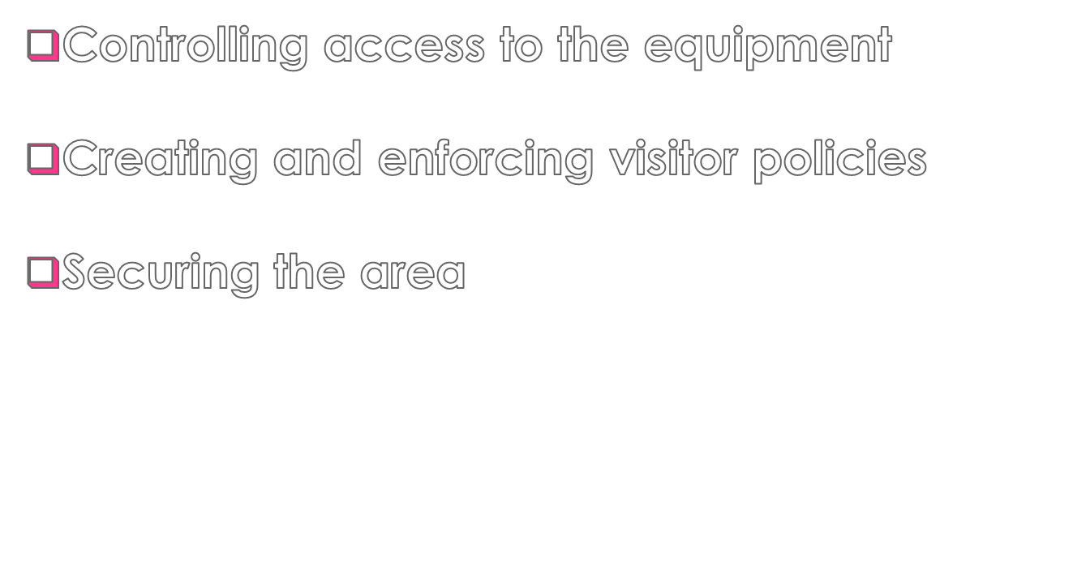

Slide 8

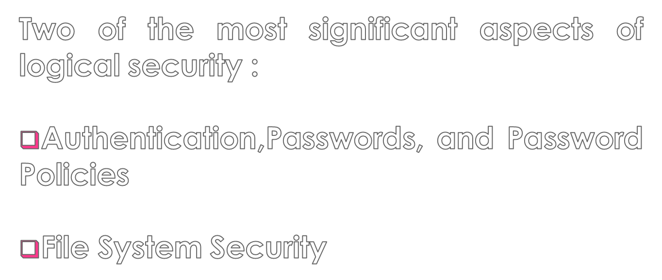

Slide 9

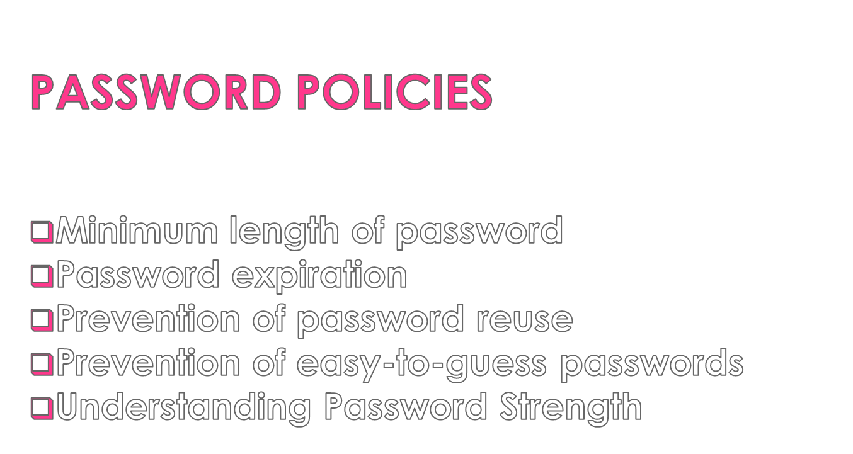

Slide 10

Novell NetWare File System Security
Unix/Linux File System Security
Windows NT 4 and Windows 2000 File System Security
File Permissions Best Practices

Slide 11

A firewall is a system or a group of systems that controls the flow of traffic between the two networks.
Its most common use is to protect a private network from a public network such as the internet.
At its most basic, a firewall is a device (it could be a computer system or a hardware device) that has more than one network interface and manages the flow of network traffic between them.

Slide 12

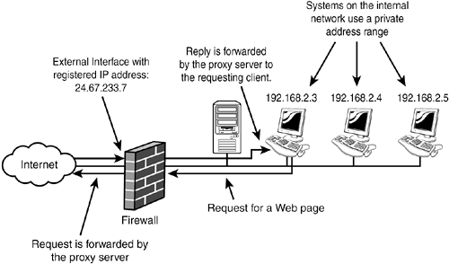
How it manages the flow and what it does with certain types of traffic depends on its configuration.
The most basic firewall configuration is given in the following figure:

Slide 13

Packet-Filtering Firewalls
Circuit-Level Firewalls
Application Gateway Firewalls

Slide 14

Packet filtering is the most commonly implemented firewall method.
It allows the firewall to examine each and every packet that passes through it.
It deals with the packets at the data-link and network layers of the Open system Interconnect (OSI) model.

Slide 15
The following are some of the criteria by which packet filtering can be implemented:
IP address
Port number
Protocol ID
MAC address

Slide 16

Similar in operation to packet-filtering firewalls.
They operate at transport layer of the OSI model.
The difference between packet-filtering firewall and a circuit level firewall is that circuit level firewall forwards all requests to the other network, using its own IP address rather than the IP address of the internal system that sent the request, which is good from a security standard.

Slide 17

It is the most functional of all the firewalls types.
They can implement sophisticated rules and closely control traffic that passes through.
It has the ability to control which system an outside user can access on the internet network.

Slide 18

A proxy server acts as an intermediary between a user on the internal network and a service on the external network.
There are a couple of reasons to implement a proxy server.
To perform NAT function
To allow Internet access to be
controlled

Slide 19

Implementing security measures has an effect on the network.
The effect of the security depends on which security measures are implemented and the habits of the network users.

Slide 20

Blocking Port Numbers
Encryption

Slide 21

It is associated with firewalls and the proxy servers.
When a port is blocked, the ability for the traffic to pass through the port is disabled.
It is implemented to prevent the users on a public network from accessing systems on a private network.
A port on a firewall should never be opened unless you are absolutely sure that you need to open it.
The more ports that are open, the more vulnerable you become to outside attacks.

Slide 22

Encryption unlocking code, is the process of encoding data so that, without the appropriate the encrypted data can’t be read.
It is increasingly being used as a means of protecting data from unauthorized users.

Slide 23

The most popular encryption methods :
Internet Protocol Security (IP Sec)
Data Encryption Standard(DES)
Triple DES (3DES)
Pretty Good Privacy (PGP)

Slide 24

Des was developed by IBM in the mid 1970s, and become a standard in 1977.
It encrypts an decrypts data in 64- bit chunks, using a 64-bit key.
Although the key is 64 bits, the actual encryption key used by DES is 56-bit key.
This is because 1 bit in every byte is reserved for parity, which leaves 56 bits.

Slide 25

DES weakness was highlighted in late 1990s, when a system which was developed for $250,000 and code-named DES cracker, shattered the DES encryption.

Slide 26

It is often referred to as “triple DES”, is an improvement on the DES encryption standard.
It is widely used, and much more stronger version and is able to provide more security of data than the traditional DES.
It performs the encryption the same way as regular DES, but it does it three times.

Slide 27
Regular DES uses 64-bit key encryption method, whereas 3DES uses three 64-bit keys, for an overall key length of 192 bits.
Like DES one of the bit in each byte is reserved for parity, therefore, the actual key is 168 bits.

Slide 28


